Slide 1
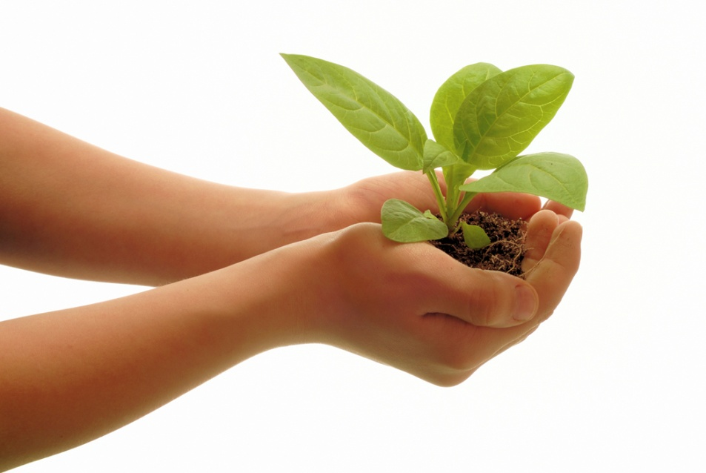
Photosynthesis & Cell Respiration

Slide 2
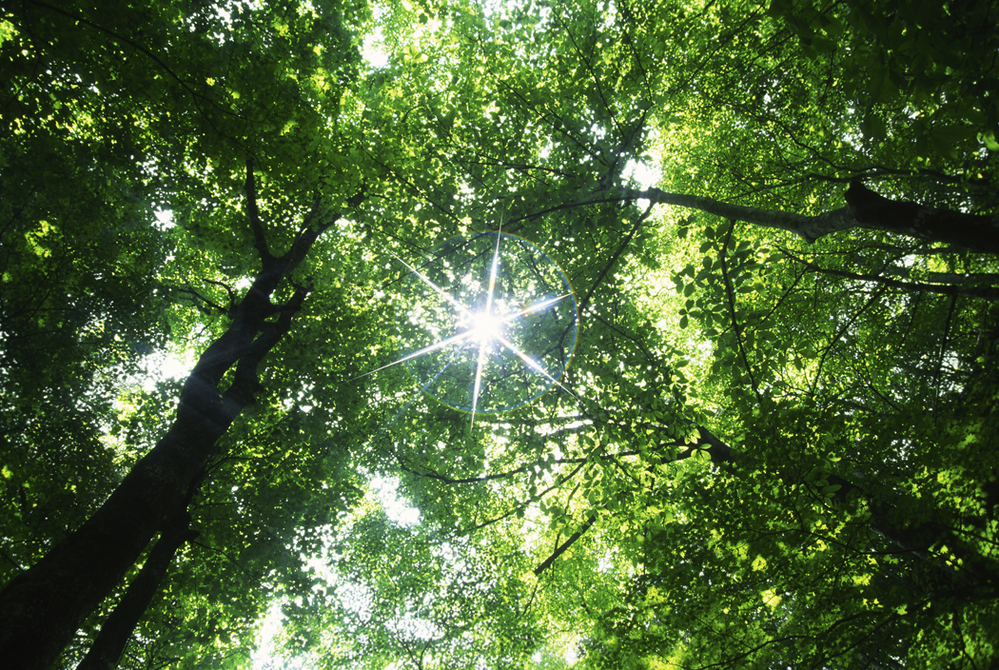
Photosynthesis
Photosynthesis is the process where plants make their own food.
During photosynthesis plants take energy from the sun, carbon dioxide from the air and water to make glucose (sugar) and oxygen.
The glucose that is made is what the plants use for food.

Slide 3
Equation for Photosynthesis
The equation for photosynthesis is:
6CO2 + 6H2O C6H12O6 + 6O2
Carbon dioxide, water & sunlight are called reactants because they are all necessary for photosynthesis to occur.
Glucose (a sugar) and oxygen are both products because they are produced from photosynthesis.
sunlight
carbon
dioxide
water
glucose
oxygen

Slide 4
Remember This!!!
Carbon dioxide (CO2), water (H2O) & sunlight
are reactants for photosynthesis (they are required).
Glucose (C6H12O2) & oxygen (O2)
are products for photosynthesis (they are made).

Slide 5
The Importance of Sunlight
Because sunlight is required for photosynthesis, sunlight is the ultimate source of all energy.
Without plants, animals would not have food to consume for energy.
Therefore, sunlight is vital for life on earth!

Slide 6
Where Does Photosynthesis Occur?
Most plants, algae and some bacteria go through photosynthesis.
Photosynthesis takes place in the chloroplast that is found within a plant and some bacteria cells.
chloroplast
plant cell

Slide 7
Photosynthesis Review
Question | Answer
What is the purpose? | To make glucose
Who does it? | Producers (plants and algae) & some bacteria
Where does it occur? | In the chloroplast
What are the reactants? | Carbon dioxide (CO2), water (H2O) & sunlight
What are the products? | Glucose (C6H12O6) & oxygen (O2)
What is the chemical conversion? | Solar energy from the sun → chemical energy in glucose

Slide 8
Remember This!!!
Photosynthesis captures the energy of light and converts it into glucose.
Glucose is a source of energy that is useable by the cell.
Photosynthesis always takes place in the chloroplasts.

Slide 9
Your Turn!
What is the purpose of photosynthesis?
What type of organisms perform photosynthesis?
Where specifically does photosynthesis occur in a plant cell?

Slide 10
Cell Respiration
Cell respiration is the process where plants and animals take glucose, made from photosynthesis, and use it to make energy.
During cell respiration, animals eat plants or other animals to get glucose. They use the glucose and oxygen to make ATP (energy), water and carbon dioxide.
The ATP that is produced provides plants and animals with the energy needed to survive.

Slide 11
Equation for Cell Respiration
The equation for cell respiration is:
C6H12O6 + 6O2 6CO2 + 6H2O + ATP
Glucose and oxygen are called reactants because they both are necessary for cell respiration to occur.
Carbon dioxide, water and ATP are all products because they are produced from cell respiration.
glucose
oxygen
carbon
dioxide
water
energy

Slide 12
Remember This!!!
Glucose (C6H12O2) & oxygen (O2) are reactants for cell respiration (they are required).
Carbon dioxide (CO2), water (H2O) & ATP
are products for cell respiration (they are made).

Slide 13
Where Does Cell Respiration Occur?
Plants and animals go through cell respiration.
Cell respiration takes place in the mitochondria found within a plant and animal cell.
plant cell
animal cell
mitochondria

Slide 14
Cell Respiration Review
Question | Answer
What is the purpose? | To make ATP (energy)
Who does it? | Producers (plants) & Consumers (animals)
Where does it occur? | In the mitochondria
What are the reactants? | Glucose (C6H12O6) & oxygen (O2)
What are the products? | Carbon dioxide (CO2), water (H2O) & ATP (energy)
What is the chemical conversion? | Chemical energy in glucose → chemical energy in ATP

Slide 15
Remember This!!!
Respiration releases the stored energy in glucose as ATP. ATP can then be used in the cell.
Respiration always takes place in the mitochondria.
All eukaryotic cells have mitochondria.

Slide 16
Your Turn
What is the purpose of respiration?
What types of organisms perform cellular respiration?
In which cell organelle is cellular respiration performed?

Slide 17
Photosynthesis & Cell Resp as a Cycle
Photosynthesis and respiration are a cycle.
Photosynthesis and respiration need each other in order to have the necessary materials to start their reaction.

Slide 18
Photosynthesis & Cell Resp as a Cycle
The products of photosynthesis, glucose and oxygen, are the reactants of cell respiration. That means, plants make the glucose and oxygen necessary for animals and plants.
Animals and plants then take the glucose and oxygen and go through cell respiration. Here the carbon dioxide and water that is necessary for photosynthesis is produced.

Slide 19
Photosynthesis & Cell Respiration as a Cycle
CO₂ + H₂O + Energy C₆H₁₂O₆ + O₂
C₆H₁₂O₆ + O₂ CO₂ + H₂O + Energy (ATP)
Photosynthesis
(the sun)
Cell Respiration

Slide 20
Your Turn!
Explain how photosynthesis and cell respiration are a cycle.
The glucose and oxygen made in Photosynthesis are the reactants in Cellular Respiration.
The water and carbon dioxide made during Cellular Respiration are the reactants in photosynthesis.

