Slide 1
Body Systems

Slide 2
Circulatory System
The major organs of the circulatory system include blood vessels and the heart

Slide 3
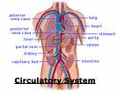
Circulatory System
The circulatory system transports nutrients and waste throughout the body

Slide 4
Circulatory System
To help maintain homeostasis, the circulatory system regulates and maintains the correct levels nutrients, oxygen, and waste products needed by cells

Slide 5
Vascular Tissue System
Similar to the circulatory system in animals, the vascular tissue system regulates and maintains correct levels of nutrients and waste products needed by plant cells

Slide 6
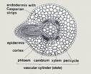
Vascular Tissue System
The major organs of the vascular tissue system are xylem and phloem
xylem transports water
phloem transports food

Slide 7
Vascular Tissue System
The vascular tissue system acts as a plumbing system that carries fluids and dissolved substances throughout plants.

Slide 8
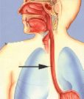
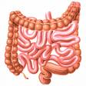
Digestive System
The major organs of the digestive system include the mouth, esophagus, stomach, large and small intestines, and the colon

Slide 9
Digestive System
The digestive system absorbs nutrients by breaking down food into usable biomolecules

Slide 10
Digestive System
The digestive system contributes to homeostasis by regulating the intake of nutrients, breaking down food molecules and absorbing them into the cells, and regulating water intake (large intestine)

Slide 11
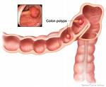
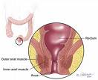
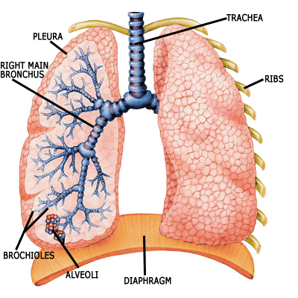
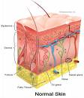
Excretory System
The major organs of the excretory system include the kidneys, liver, bladder, colon, rectum, lungs, and skin

Slide 12
Excretory System
The excretory systems removes waste from the body

Slide 13
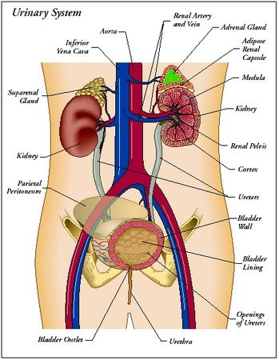
Excretory System
The excretory system helps maintain homeostasis by removing all waste material from the body; the skin sweats (which also helps to cool the body); the kidneys filter chemicals in the blood; the liver filters toxins and acids from the blood; and the colon allows solid waste to pass from the body

Slide 14
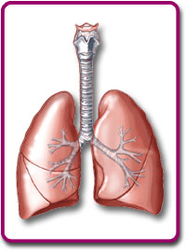
Respiratory System
The major organs of the respiratory system include the lungs

Slide 15
Respiratory System
The respiratory system moves oxygen into the body while removing carbon dioxide (CO₂) from the body

Slide 16
Respiratory System
The respiratory system helps maintain homeostasis by bringing in necessary levels of oxygen while removing harmful CO₂

Slide 17
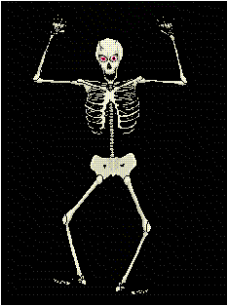
Skeletal System
The skeletal system is composed of bones

Slide 18
Skeletal System
The skeletal system protects and supports other body systems

Slide 19
Skeletal System
The skeletal system helps maintain homeostasis by supporting organs and keeping them in place which allows for proper function and directly interacts with muscles

Slide 20
Muscular System
The muscular system includes voluntary and involuntary muscles

Slide 21
Muscular System
The muscular system allows for movement

Slide 22
Muscular System
The muscular system helps maintain homeostasis by allowing movement and the body to return back into place after changing position; many involuntary muscles constantly regulate body functions such as breathing and heartbeat

Slide 23
Endocrine System
The major organs of the endocrine system include glands and the brain

Slide 24
Endocrine System
The endocrine system regulates and sends hormones throughout the body

Slide 25
Endocrine System
The endocrine system is responsible for regulation from the hormone messages such as temperature, hunger, sleep, etc.

Slide 26
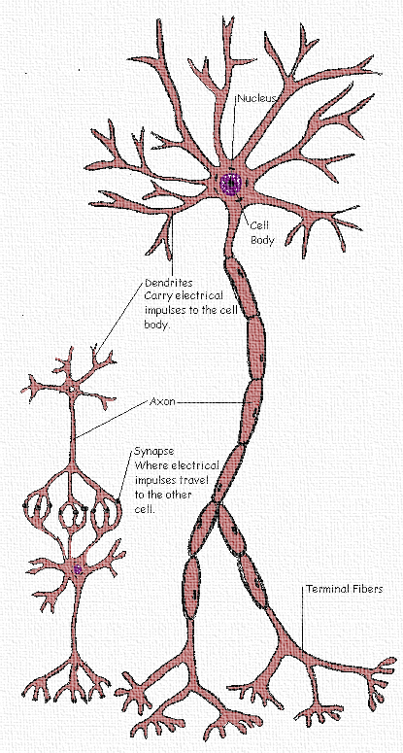
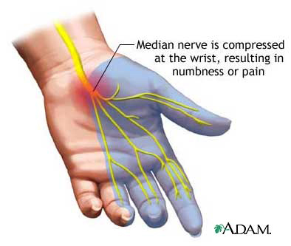
Nervous System
The major organs of the nervous system include nerves and the brain

Slide 27
Nervous System
The nervous system sends chemical messages throughout the body

Slide 28
Nervous System
The nervous system helps maintain homeostasis by sending chemical messages to the brain that tell the status of pain, temperature, hunger, etc. so that the body can make adjustments using other systems

Slide 29
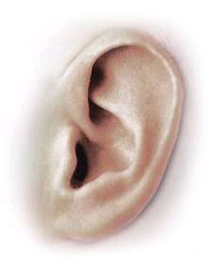
Sensory Organs
Sensory organs include the skin, eyes, ears, nose, tongue

Slide 30
Sensory Organs
The sensory organs are constantly adjusting to body conditions to respond to changes in the environment

Slide 31
Sensory Organs
The sensory organs help maintain homeostasis by working with the nervous system and maintaining internal temperature

Slide 32
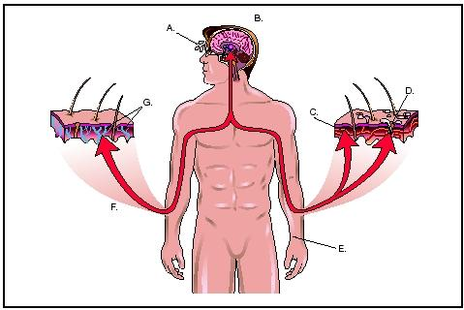
Body Systems
What four systems are involved in regulating internal body temperature?
nervous
endocrine
excretory
circulatory

Slide 33
